Slide 1


Slide 2
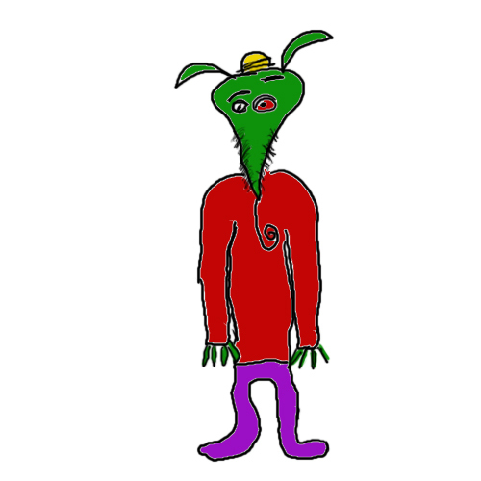
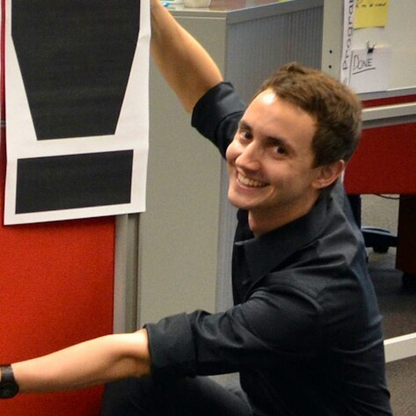
@whereismytaco
@romainprieto

Slide 3
WHNBHB

Slide 4

Notes:
Anybody has any news?
A few things to mention

Slide 5
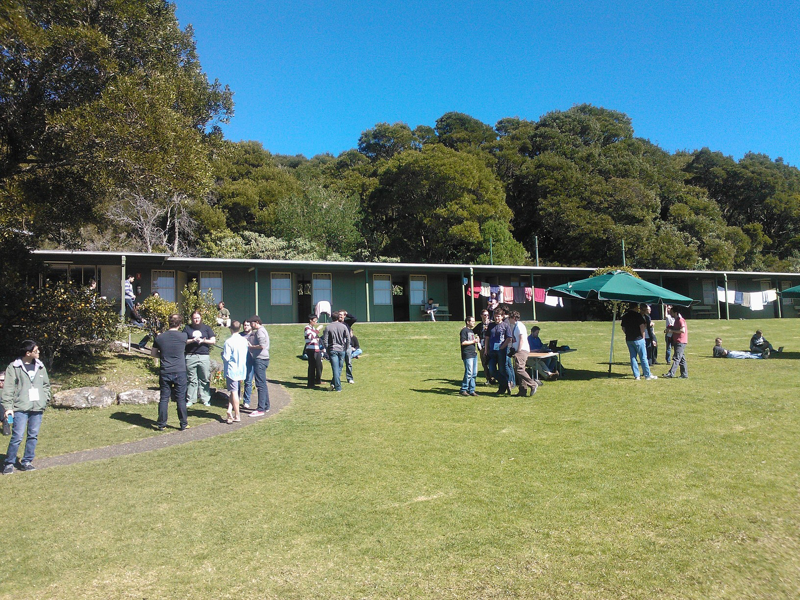
Notes:
CampJS: summary anymore? Code & fun

Slide 6
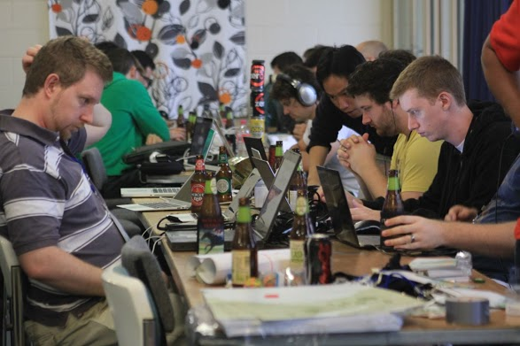

Slide 7
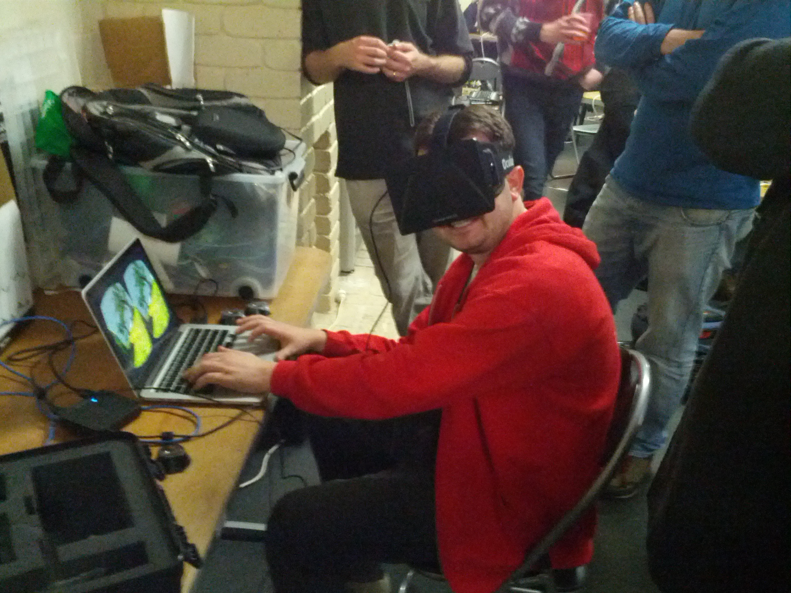
Notes:
Oculus Rift

Slide 8
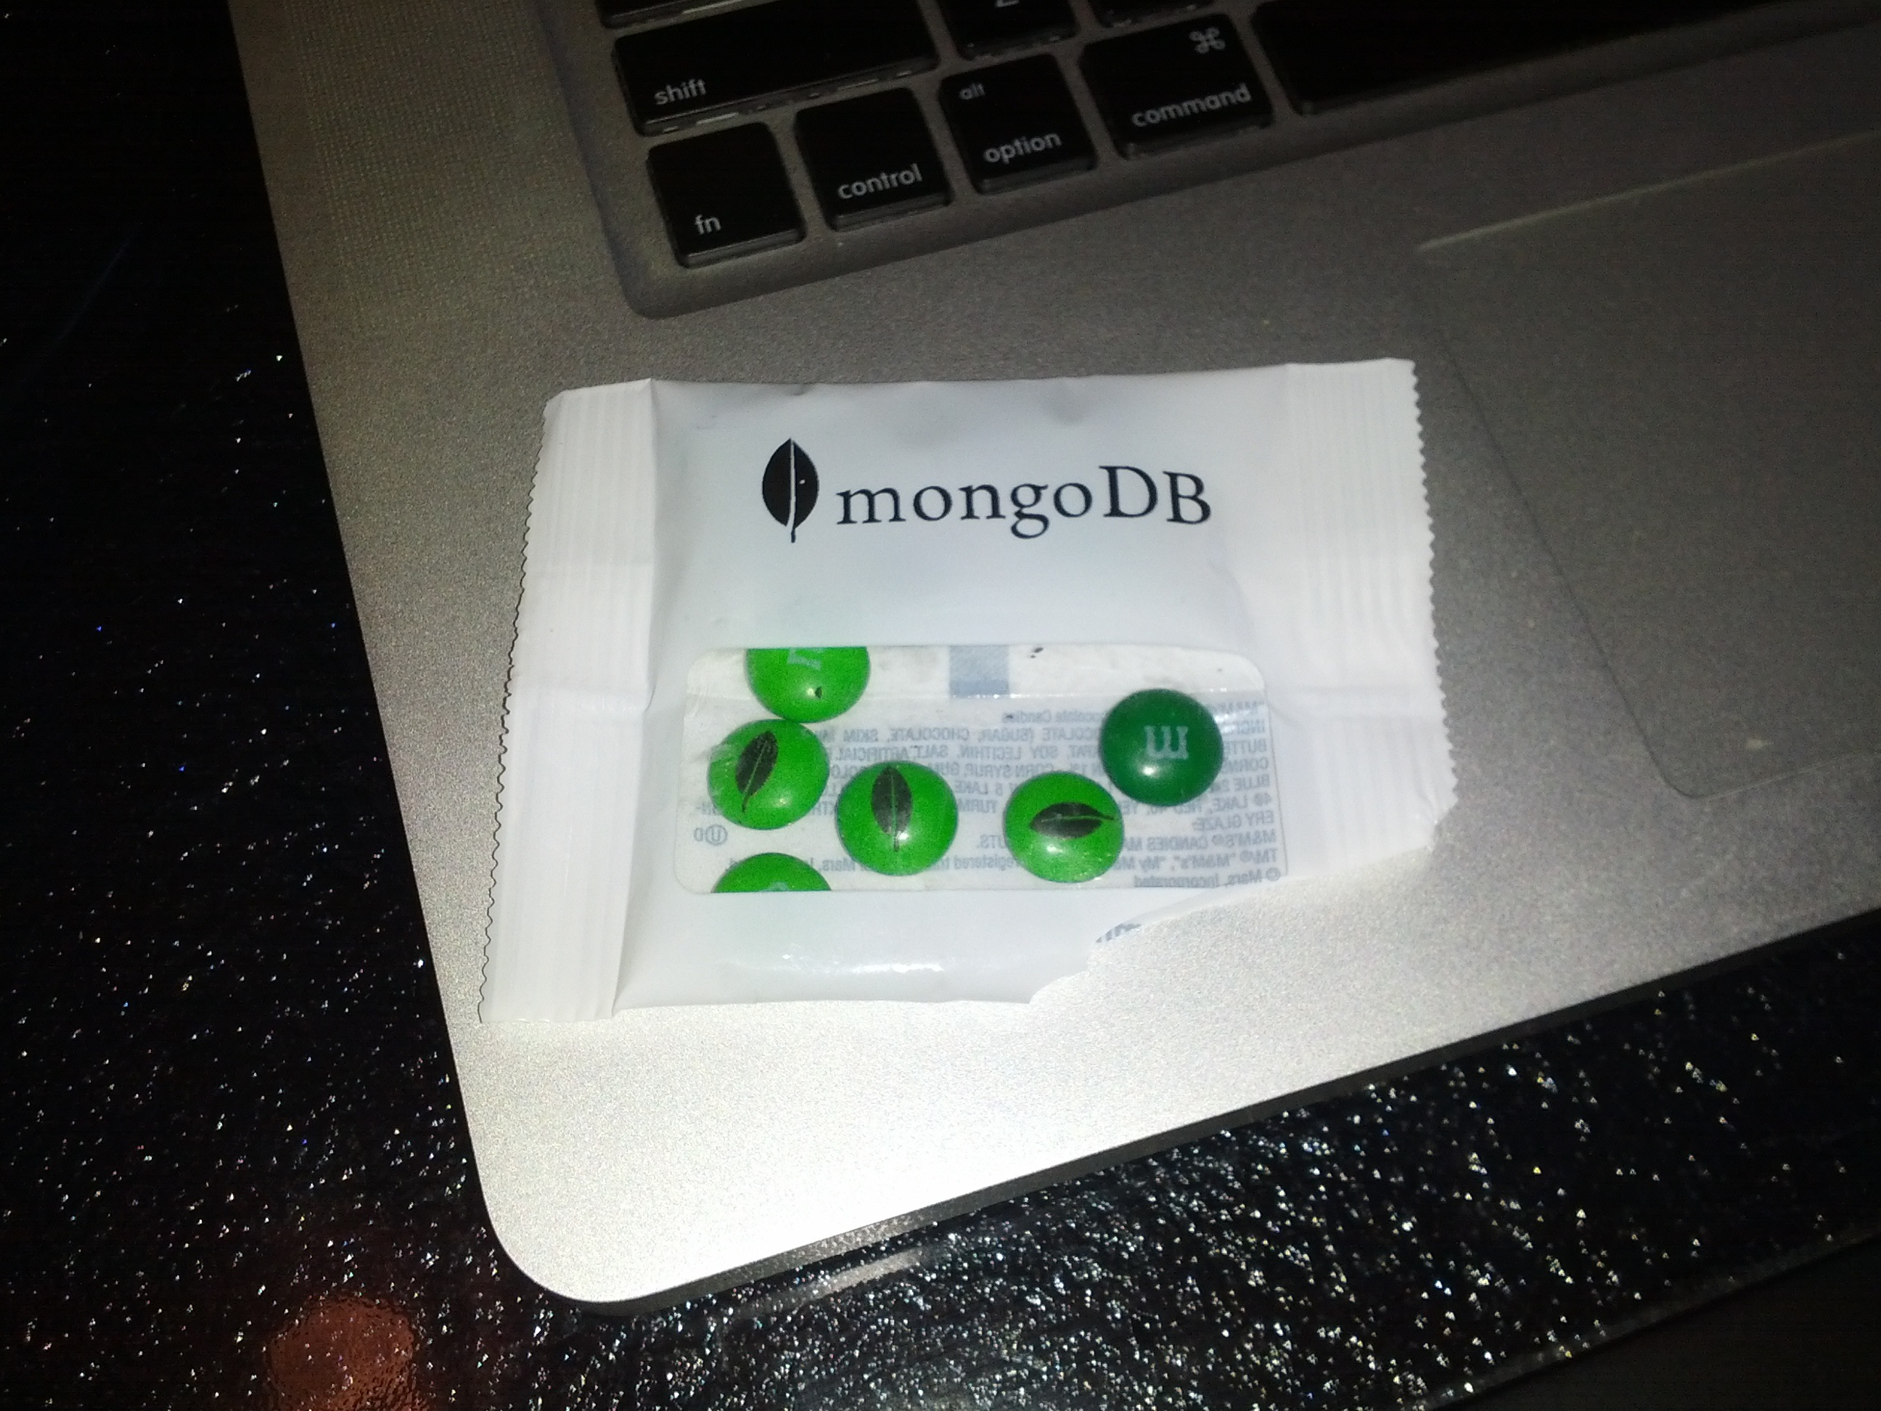
Notes:
Where else can you get mongodb M&Ms

Slide 9
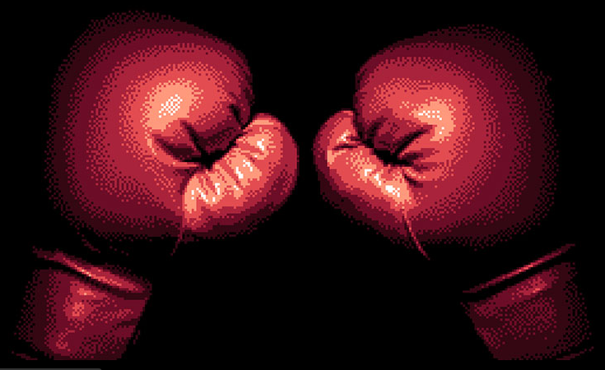
Notes:
Node knockout = competition
Rego open Tuesday (17th)
Coding = 48 hours, starting Nov 9th

Slide 10
tonight

Slide 11
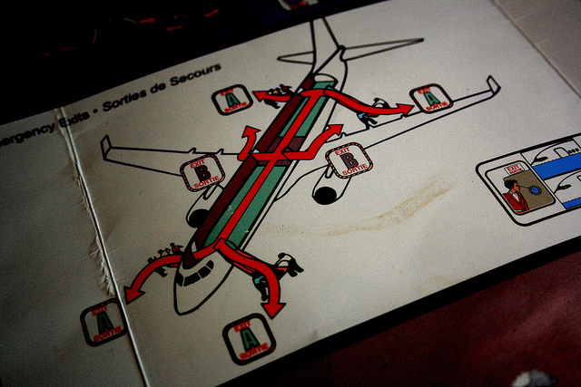
Notes:
Bathrooms this way
Beer and pizza that way

Slide 12

Notes:
Thanks to TW

Slide 13
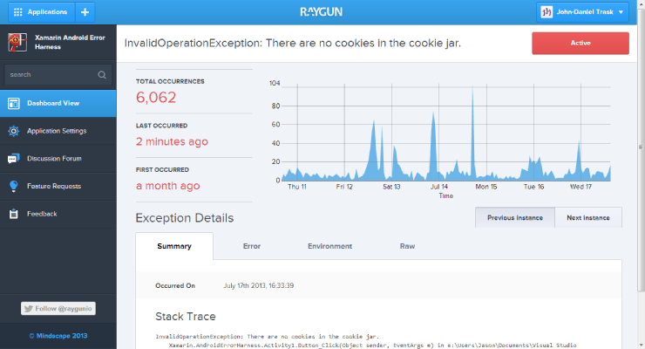
Notes:
Raygun.io Monitoring for Node.js sent us t-shirts

Slide 14

Notes:
Thanks to TW

Slide 15
tonight

Slide 16

Notes:
Usually 2 presos
Math inclined = 3!

Slide 17
Richard Kennard
UI generation with MetaWidgets

Slide 18
Joshua Clulow
News from Joyent
(Manta and more)

Slide 19
Nik Butenko
Sharing client
& server entities

Slide 20


Slide 21

Notes:
Node in the wild
Built anything hardware related, please come and present!

Slide 22
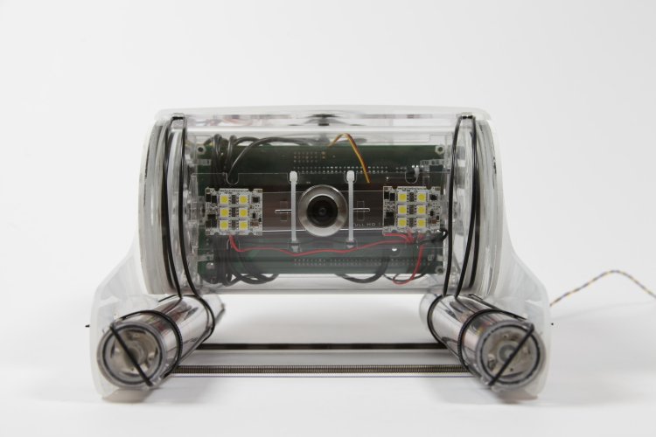
Notes:
Dominik will be talking about Open ROV
Node.js to drive a robot under water!

